Slide 1
NEO4J CYPHER TUTORIAL WITH PYTHON
Load Multiple Json Files In Neo4j Using Cypher ,Apoc & Python
Tutorial 85

Slide 2
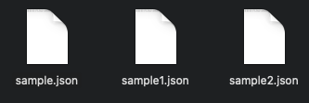
Multiple Json files

Slide 3
Use case
Load Multiple Json Files In Neo4j Cypher using apoc procedure

Slide 4
Pre-requisites
apoc.import.file.enabled=true
apoc.import.file.use_neo4j_config=false

Slide 5
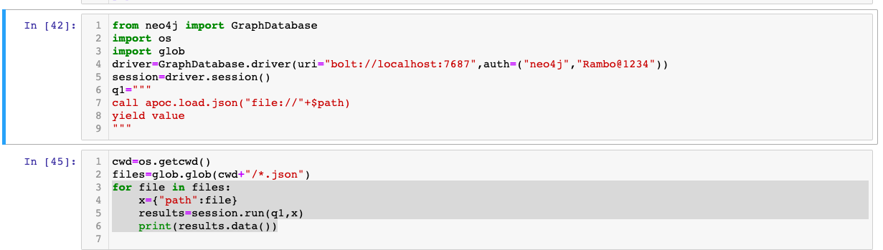
Load multiple json files using apoc procedures
code

Slide 6
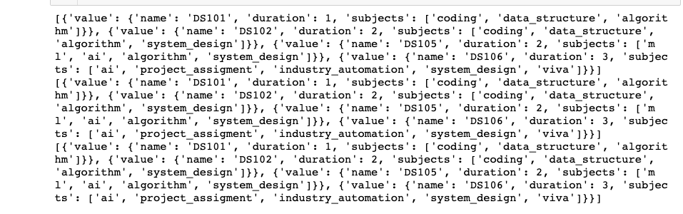
output
From python ide

